Slide 1
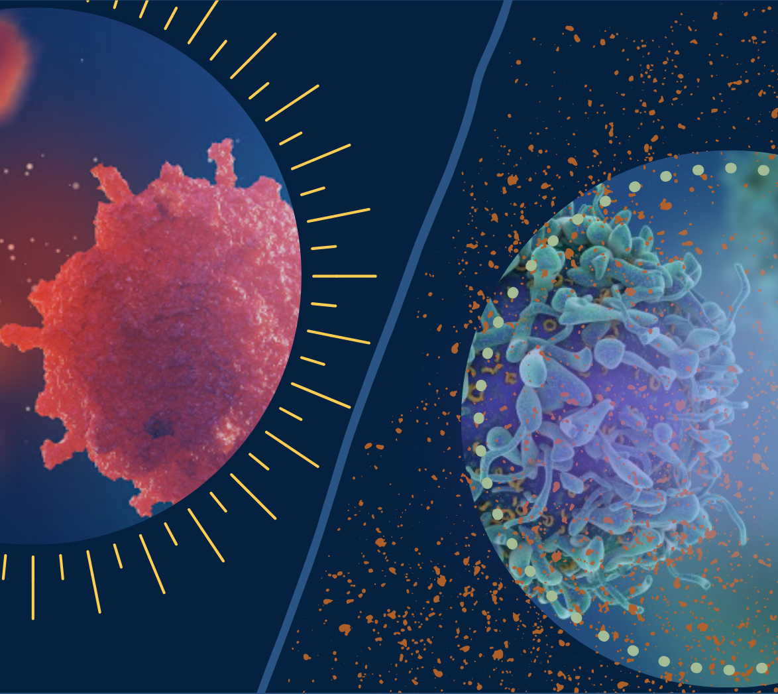
MELANOMA CLASSIFICATION
Guide : Dr. Niladri Bihari Puhan
Notes:
Skin cancer is common cancer type and despite beign mostly non malignant, due to high case numbers it's pretty serious diasease and can lead serious cases if not detected, treated in time. It's usually diagnosed by eye for primarily and followed by further clinical analysis if needed. Even though the rares outcome is called melanoma it's the most deadly one, so early detection is pretty important. For this task using computer aided diagnosis might be helpful for primarily steps and early detections. Better detection might save thousands of lives. The Goal is to develop a model that can predict a probablity that the given lession is malignant

Slide 2
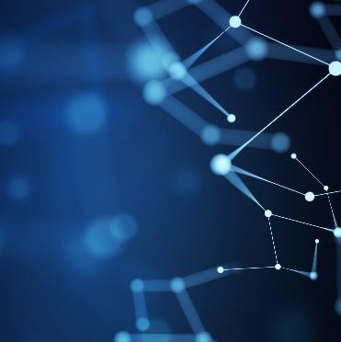
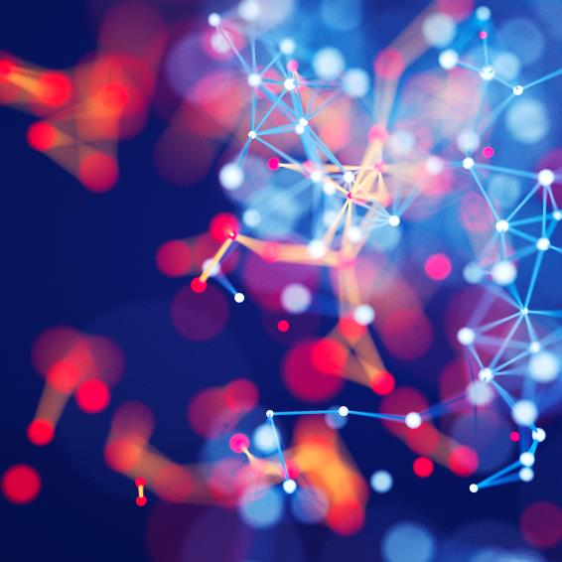
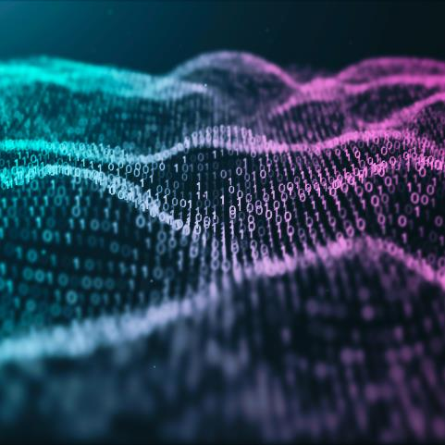
Table of Contents
MOTIVATION
HISTORY
DATABASE
ARCHITECTURE
TRAINING
RESULTS
FUTURE PLANS

Slide 3

01 Motivation
Detect & Treat

Slide 4





What is Melanoma?
MELANOMA
CURE
EARLY DETECTION
Skin Cancer,
Originated from melanocyte cells, Increasing occurrence
Tumor stage V : 9-15%
Aggressive, metastasis
Treatment in early stage : 90%
DERMOSCOPY
BIOPSY
TECHNOLOGY
Noninvasive, in vovo technique
Expensive and in case of benign moles an unnecessary surgery
Improve better techniques to help early detection of melanoma
Notes:
Melanoma is a deadly disease, but if caught early, most melanomas can be cured with minor surgery. Image analysis tools that automate the diagnosis of melanoma will improve dermatologists' diagnostic accuracy. Better detection of melanoma has the opportunity to positively impact millions of people. We'll dentify Melanoma in images of skin lesions. In particular, we’ll use images within the same patient and determine which are likely to represent a melanoma. Using patient-level contextual information may help the development of image analysis tools, which could better support clinical dermatologists.

Slide 5

MELANOMA AND AI
PATTERN RECOGNITION
Specific morphological features
Computer Vision
CNN

Slide 6

02 History
Technology & Dermatology

Slide 7
Review of Past
Szegedy:
Inception V3
He:
ResNet50
Esteva:
Database, CNN, Mobile application
2007
2016
2010
2019
1994
Pan:
Transfer Learning
Tan:
EfficientNetB7
Binder:
ANN
ELM pattern analysis

Slide 8
03 Database
SIIM-ISIC

Slide 9

SIIM-ISIC
Images are provided in DICOM format.
Metadata is of the DICOM format, in CSV files.
Images in TF-Record format have been resized to a uniform 1024x1024.
Notes:
The images are provided in DICOM format. This can be accessed using commonly-available libraries like pydicom, and contains both image and metadata. It is a commonly used medical imaging data format.
Images are also provided in JPEG and TFRecord format (in the jpeg and tfrecords directories, respectively). Images in TFRecord format have been resized to a uniform 1024x1024.
Metadata is also provided outside of the DICOM format, in CSV files.
image_name - unique identifier, points to filename of related DICOM image
patient_id - unique patient identifier
sex - the sex of the patient (when unknown, will be blank)
age_approx - approximate patient age at time of imaging
anatom_site_general_challenge - location of imaged site
diagnosis - detailed diagnosis information (train only)
benign_malignant - indicator of malignancy of imaged lesion
target - binarized version of the target variable

Slide 10
Data Description
Train :
Image name
Patient_id
Sex
Age_approx
Anatom_site_general_challenge
Diagnosis
Benign_malignant
Target

Slide 11
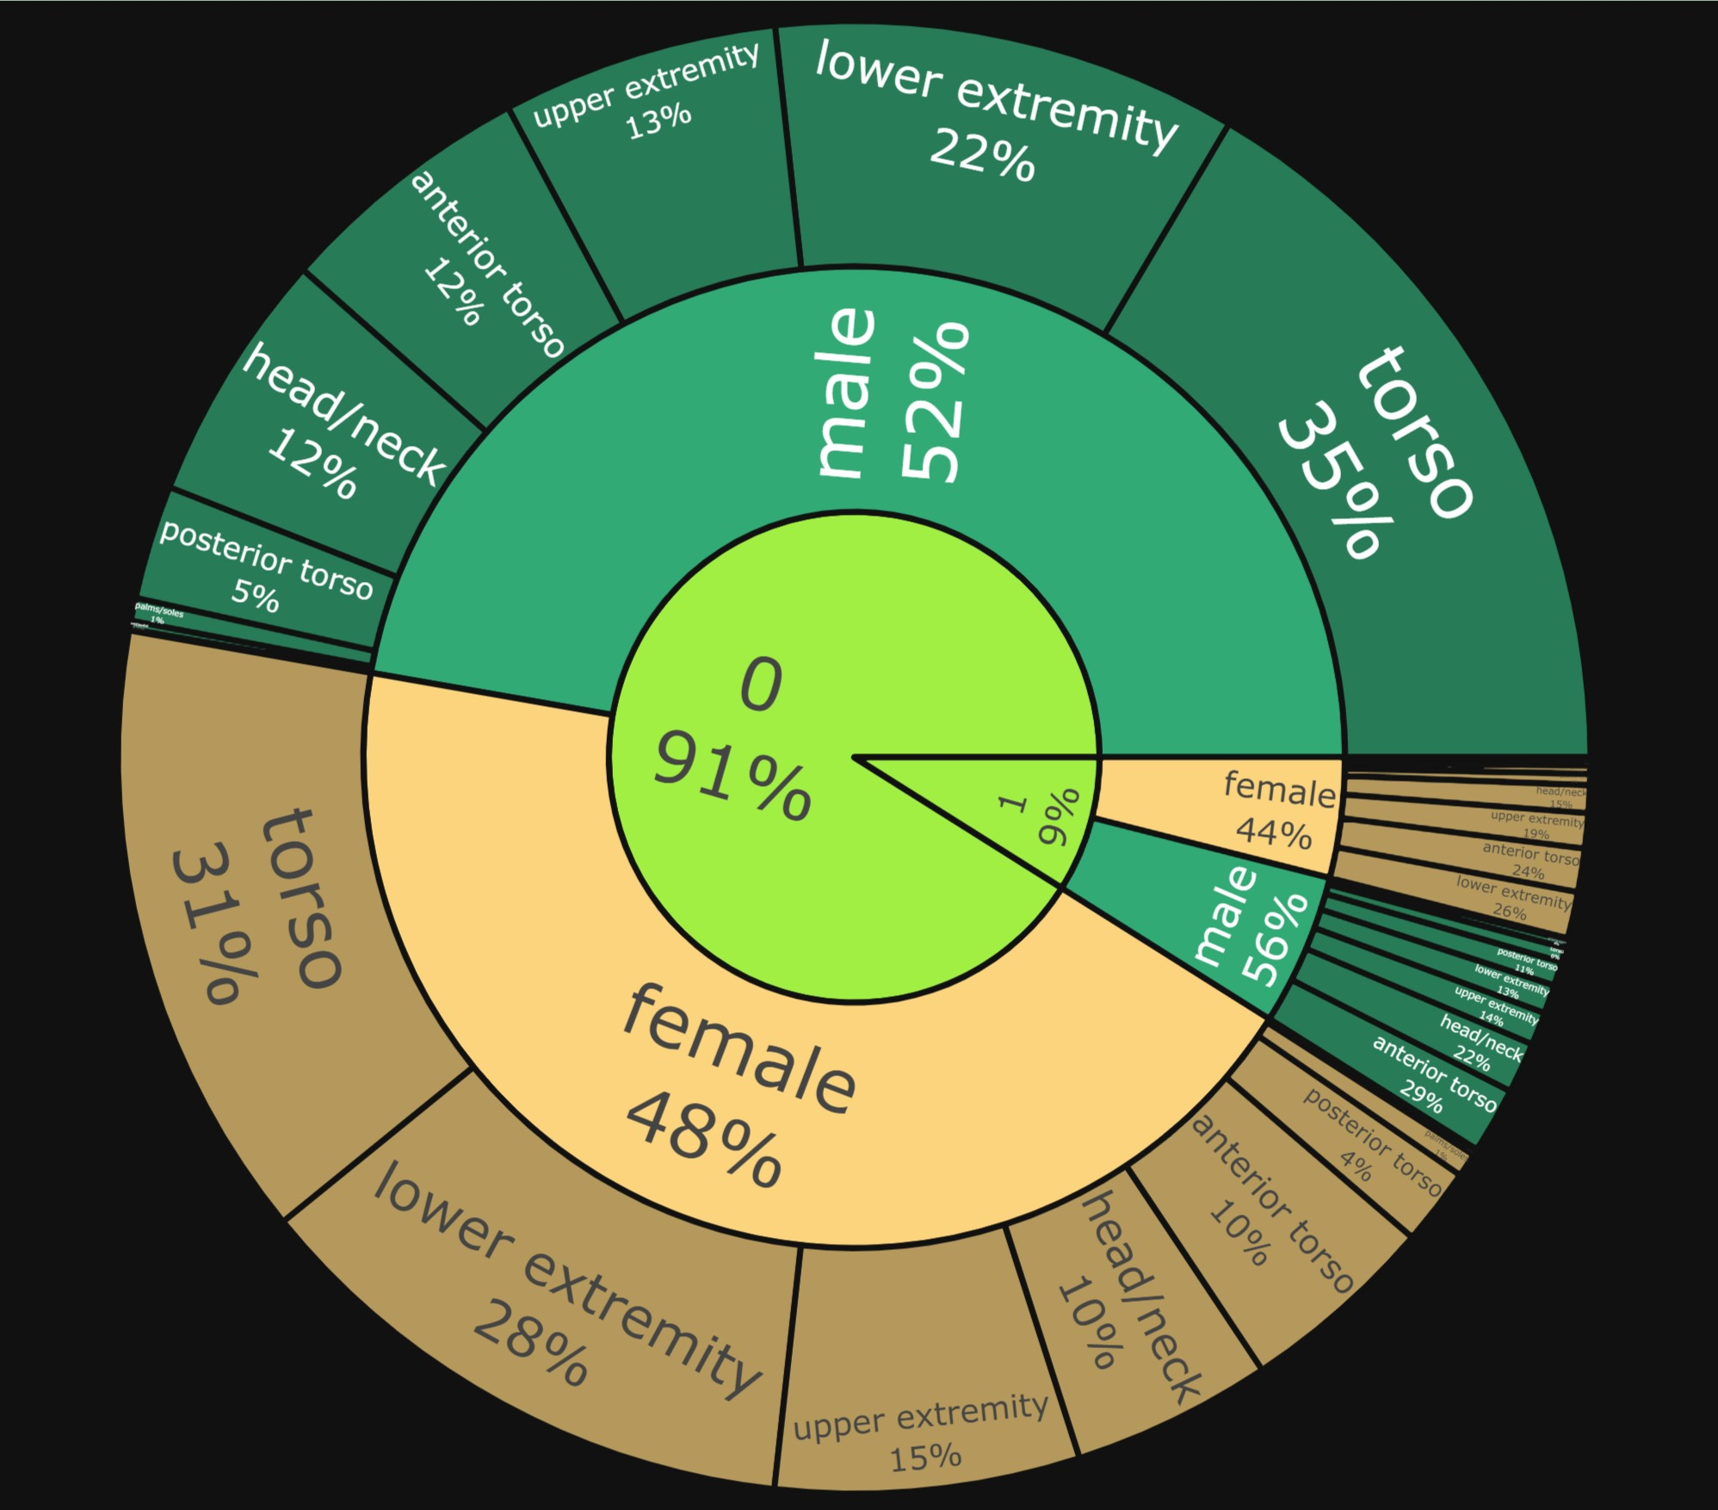
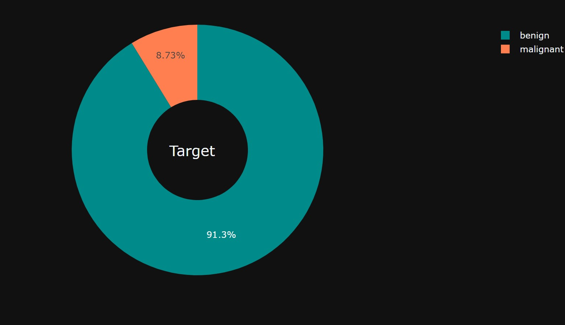
Charts
Donut Chart of Target
Sun Burst Chart of Benign,Malignant

Slide 12
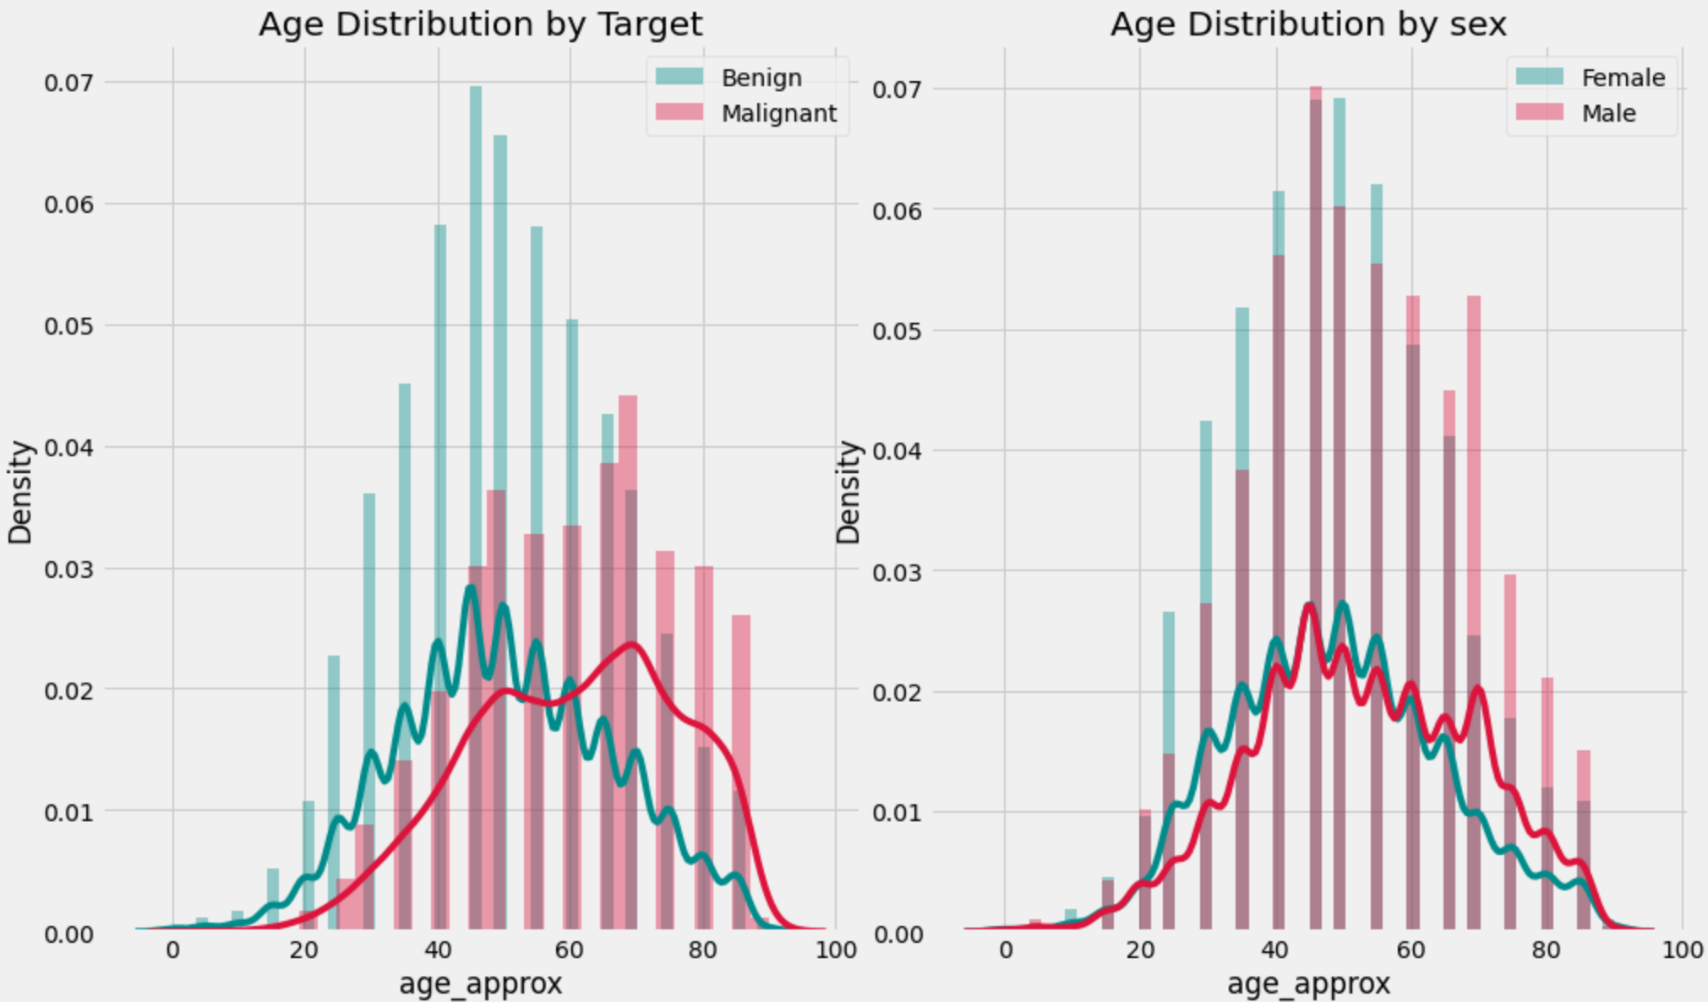
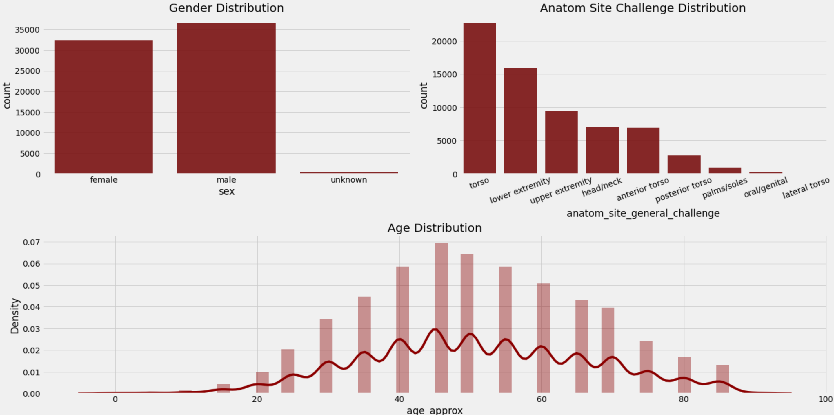
Data Analysis
Notes:
Observations:-
Men and Female have almost same counts.
In Anatom Site Challenge there are different types of torso.3. Age follows Normal Distribution.
Observations:-
Age Distributions of Malignant & are different.
The Mean of Benign is less then that of Malignant.
Age Distributions of Male and Female are close but males have high values.
The Probablity of occuring a melanoma at age of 20 and 70.

Slide 13
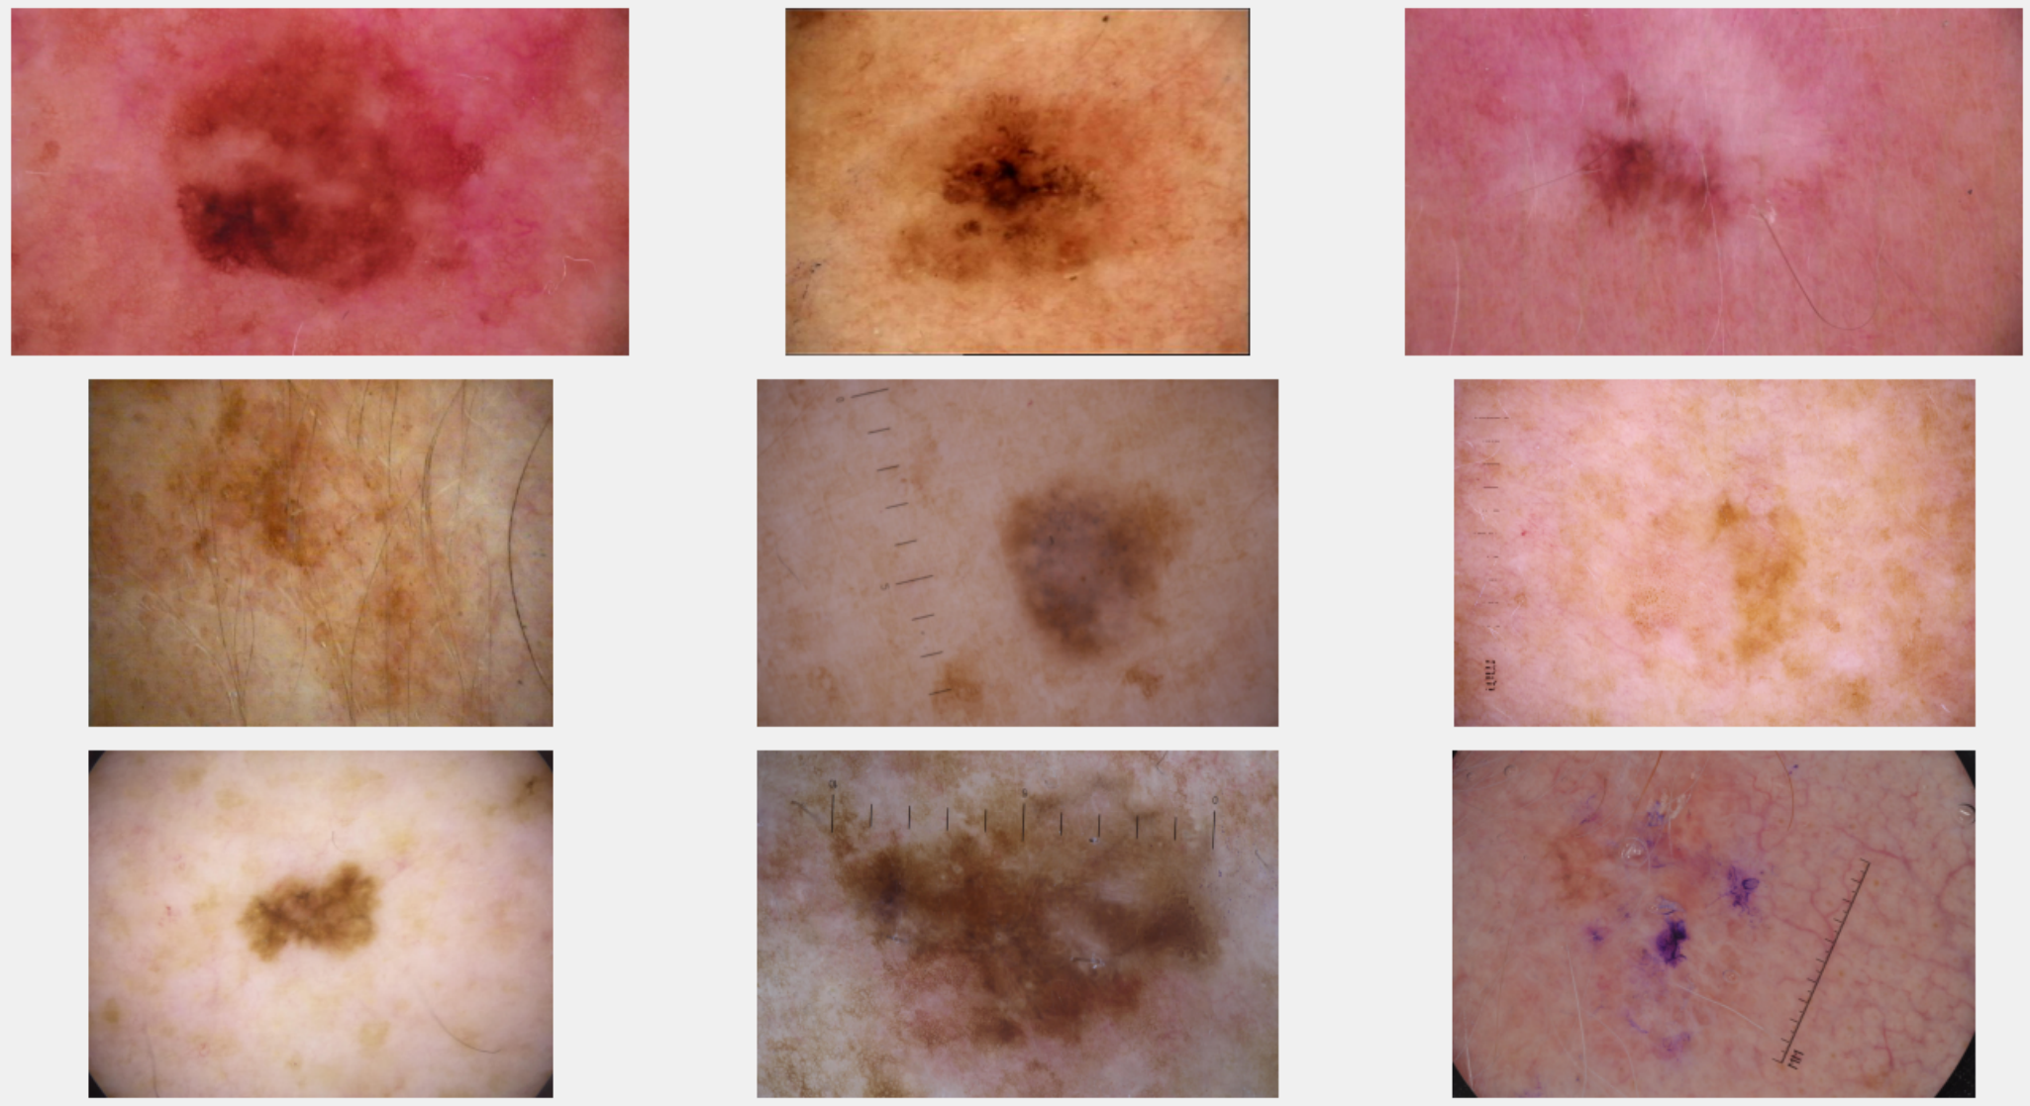
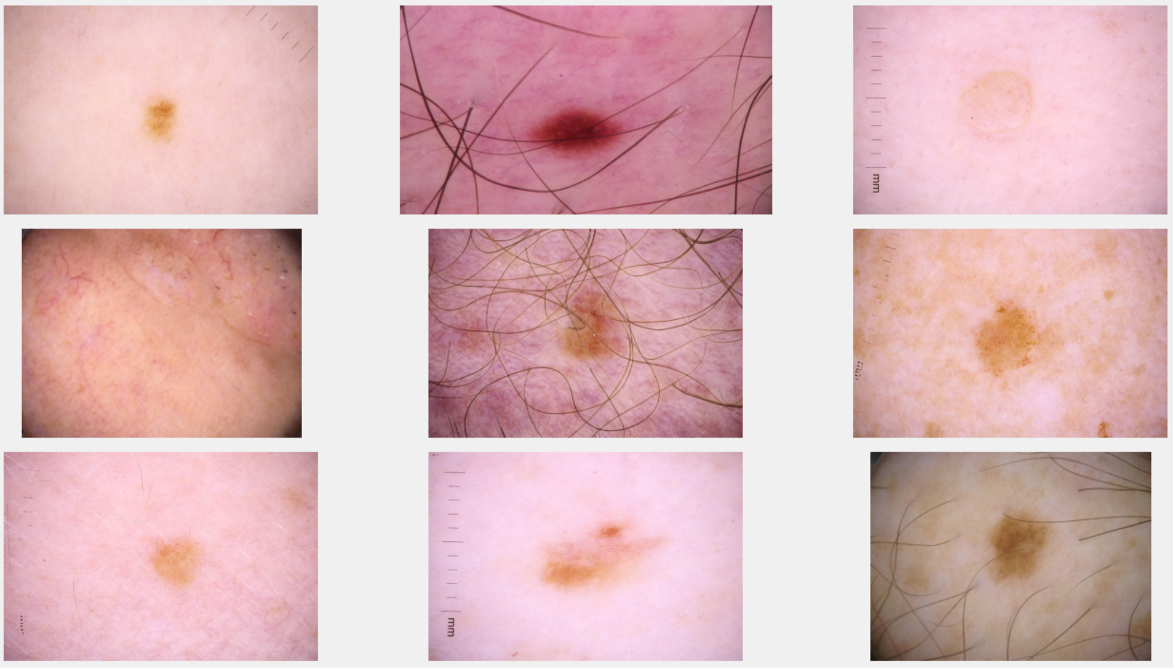
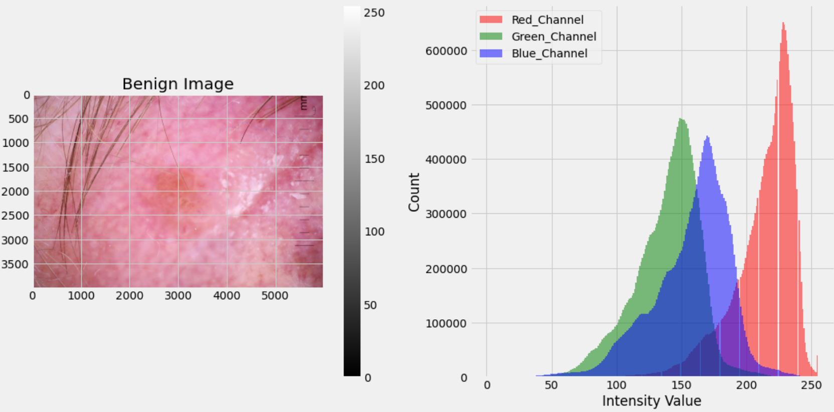
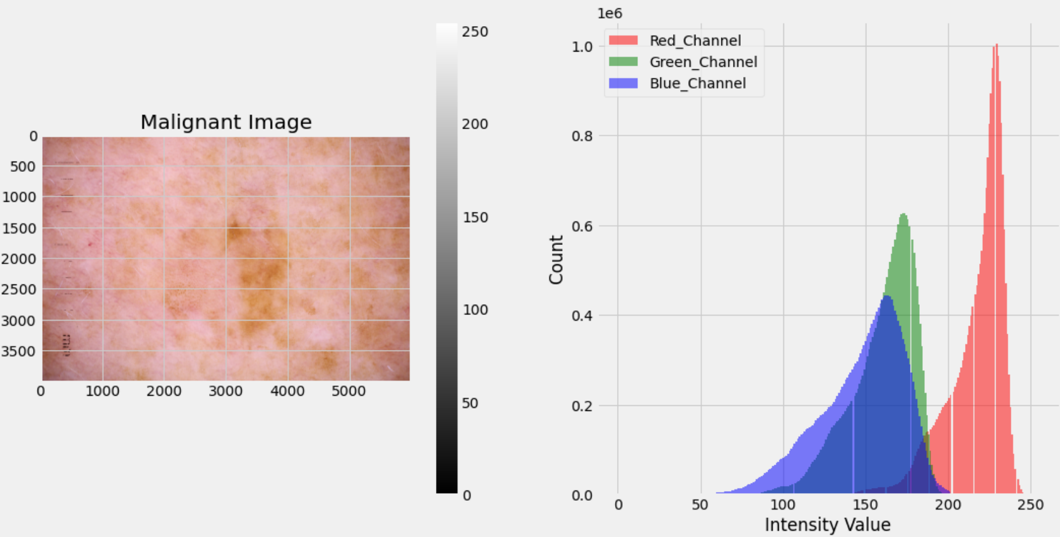
Images
Notes:
Benign Images
Malignant Images

Slide 14
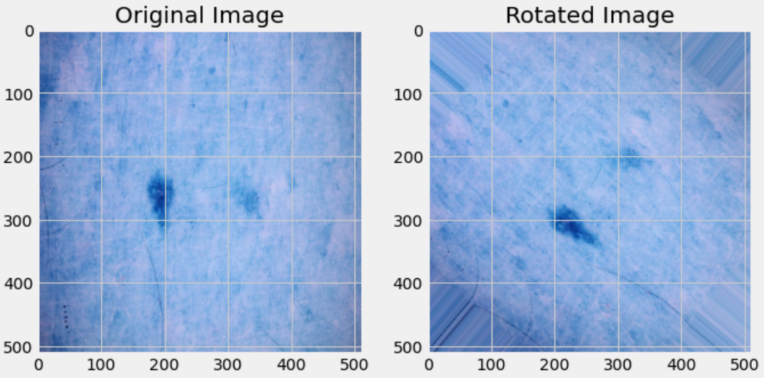
Data Augmentation
Data augmentation significantly increases the diversity of data available for training our models, without actually collecting new data samples.
A technique to increase the diversity of your training set by applying random (but realistic) transformations, such as image rotation.
Spacial transformation involves a set of basic data augumentation solutions, such as random scale, crop, flip and random rotation.
Notes:
So like above we can implement any operation like shear,zoom,shift etc the difference is only in step 2 & 3. In step 2 we calculate the matrix corresponding to that operation and in step 3 just apply that matrix. So like in case of rotation the destination pixels indices were rotated on the original image in case of shift operation they will be shifted. The step 4 remains same.

Slide 15
04 Architecture
How to implement transfer learning?

Slide 16
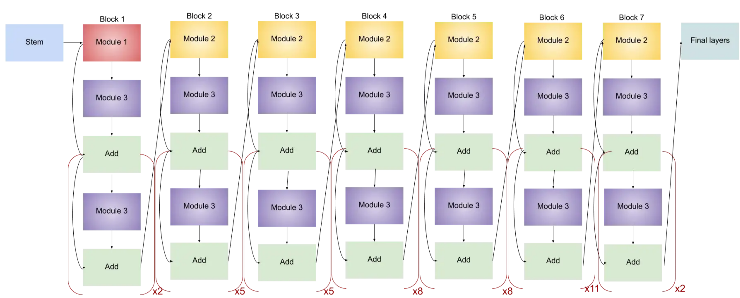
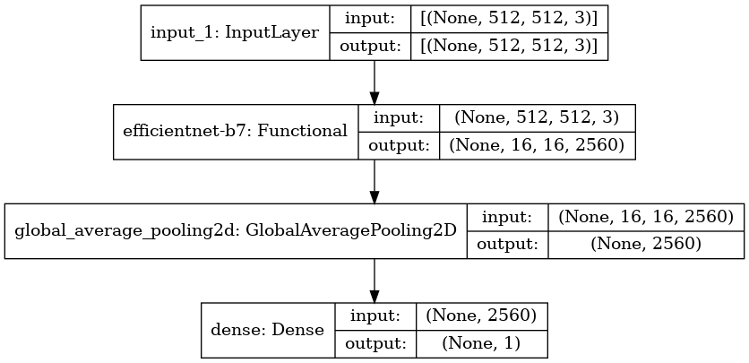
Model Architecture
Binary Classification
CNN
Transfer Learning
Base: EfficientNetB7
Architecture of EfficientNet-B7
Notes:
Here we used EfficientNet-B7 architecture. In EfficientNet they are scaled in a more principled way i.e. gradually everything is increased. Common things are
1. first thing is any network is its stem after which all the experimenting with the architecture starts which is common in all the eight models and the final layers. After this each of them contains 7 blocks. These blocks further have a varying number of sub-blocks whose number is increased as we move from EfficientNetB0 to EfficientNetB7.

Slide 17
05 Training
Train & Test & Validation

Slide 18
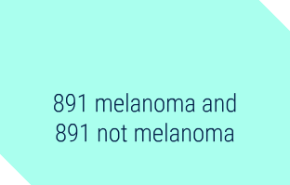

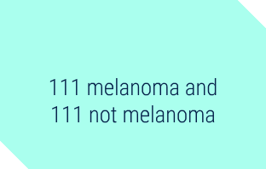
Splitting Datasets
TRAIN
DATASETS
Datasets should be balanced for binary classification
VALIDATION
TEST
Notes:
Train – 35,000 images
Vlidation – 15000 images

Slide 19
HyperParameters
Number of Epochs
Batch Size
Learning Rate
Optimizer
Image Size
Step per epoch
EfficientNetB7
15
16
0.00003
Adam
512x512
241

Slide 20
06 Results
Model Performance

Slide 21
Results
93.90 %
EfficientNetB7 accuracy
0.1540 %
EfficientNetB7 loss

Slide 22
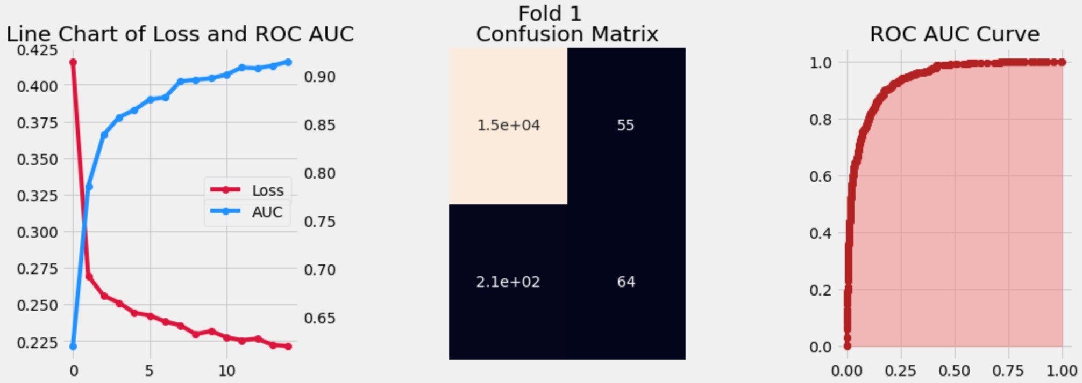
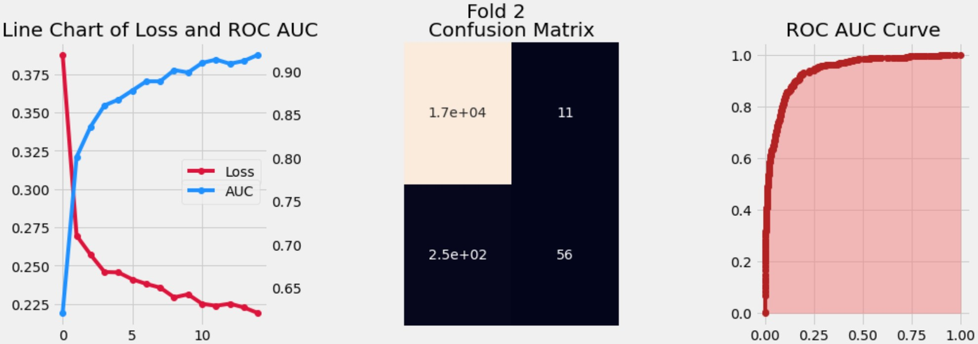
Folds
Fold-1
Fold-2

Slide 23
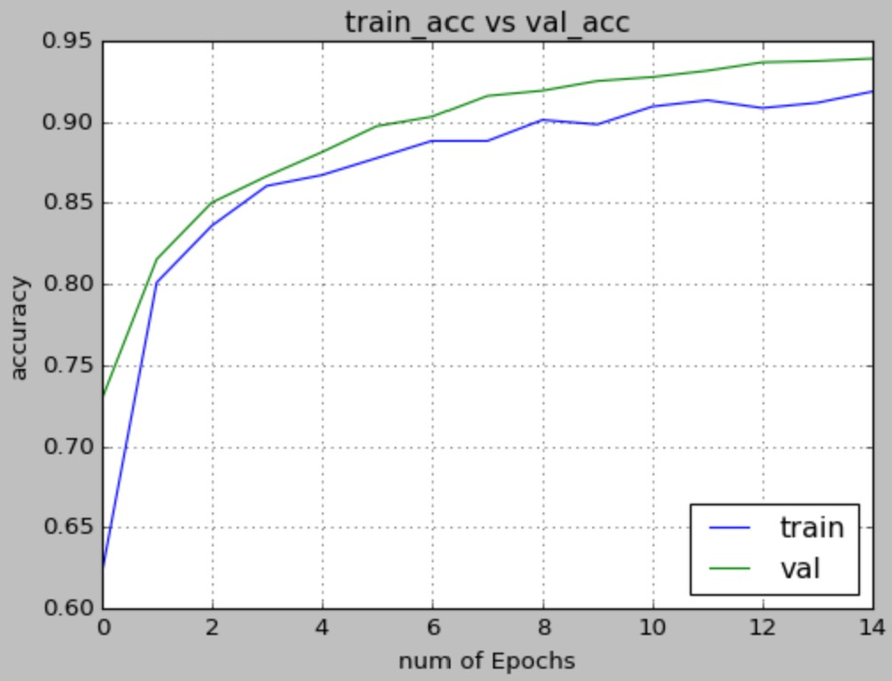
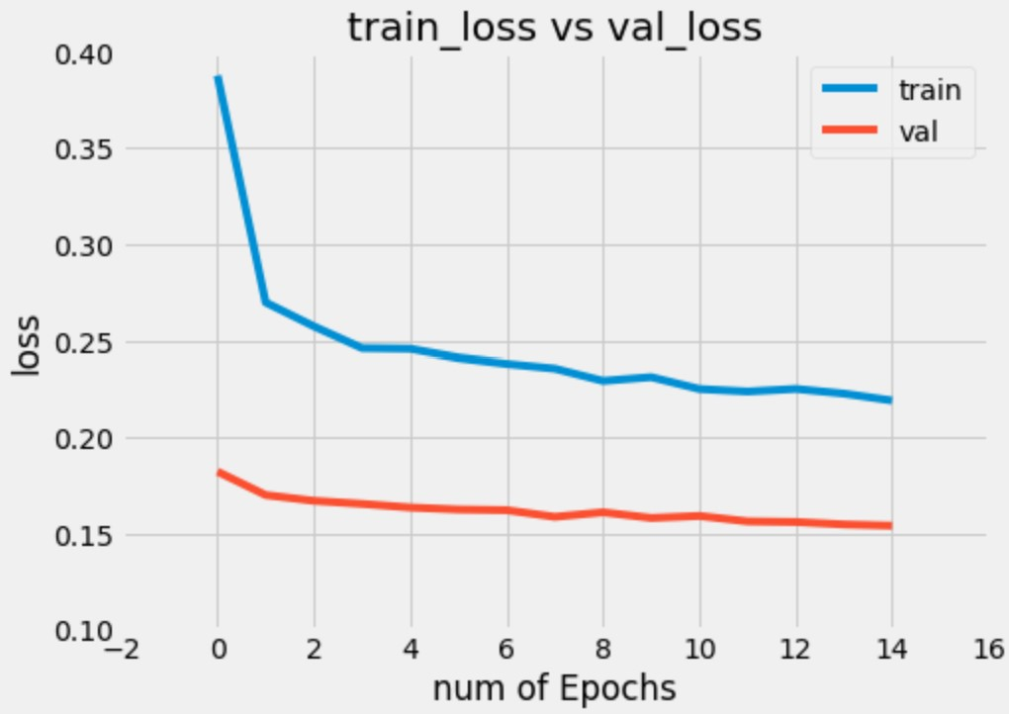
Plots

Slide 24
08 Future Plans
Ideas & Opportunities

Slide 25



Future Plans
RESNET
Automatic hyperparameter optimizations to improve model accuracy
MOBILE APP
As base model to get an overall picture of transfer learning techniques, and to choose the best model
Giving access for everyone to check if they have melanoma or not
HYPERAS

Slide 26
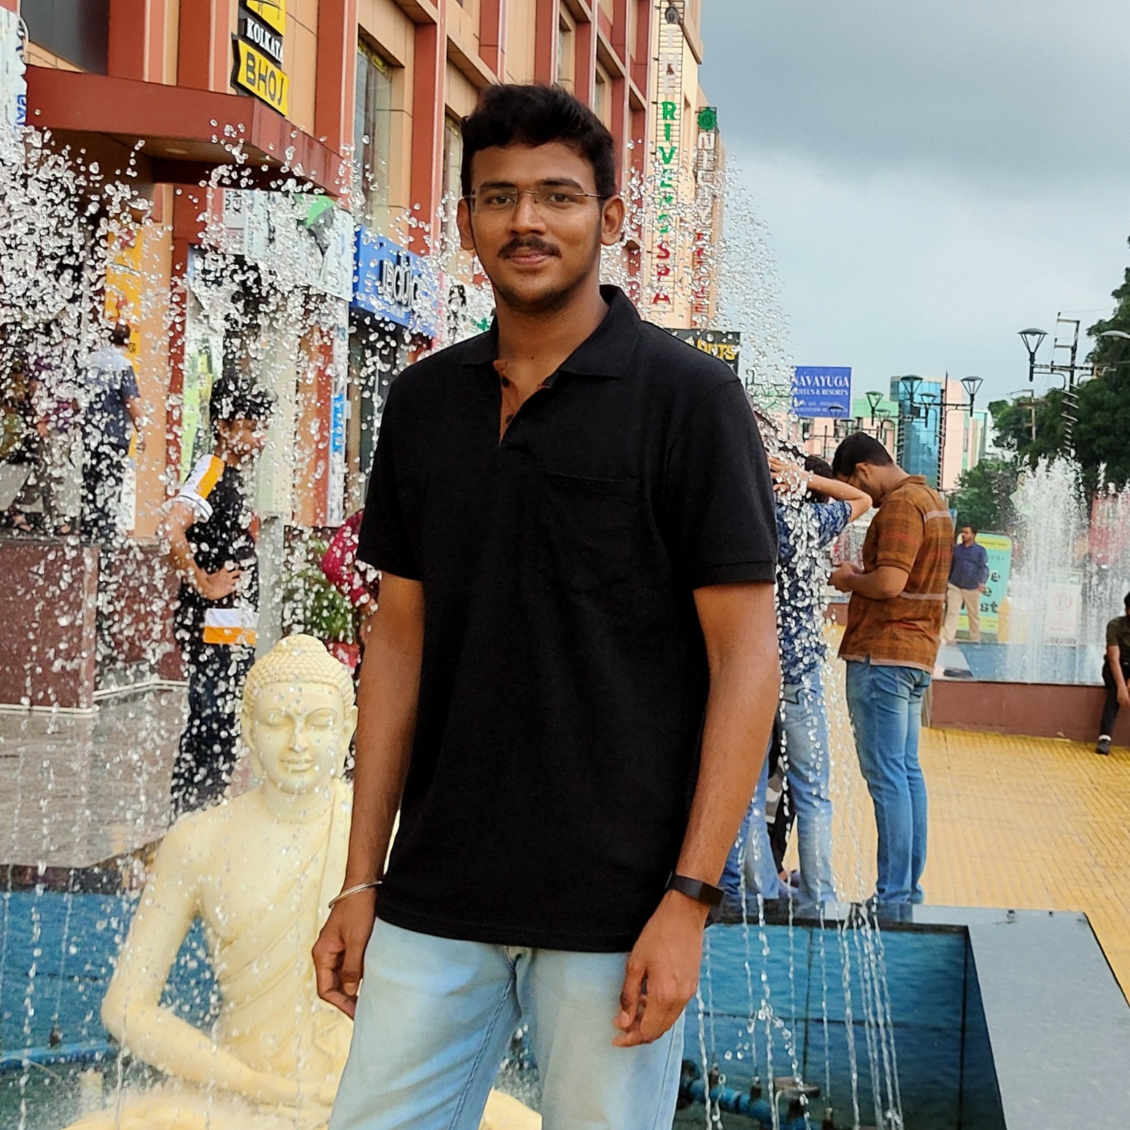

Team
J. Shyam Sai
B. Harsha Vardhan
19EE01025
19EE01036

Slide 27

THANK YOU

